Slide 1


24 May 2021
Radford Burger

Slide 2

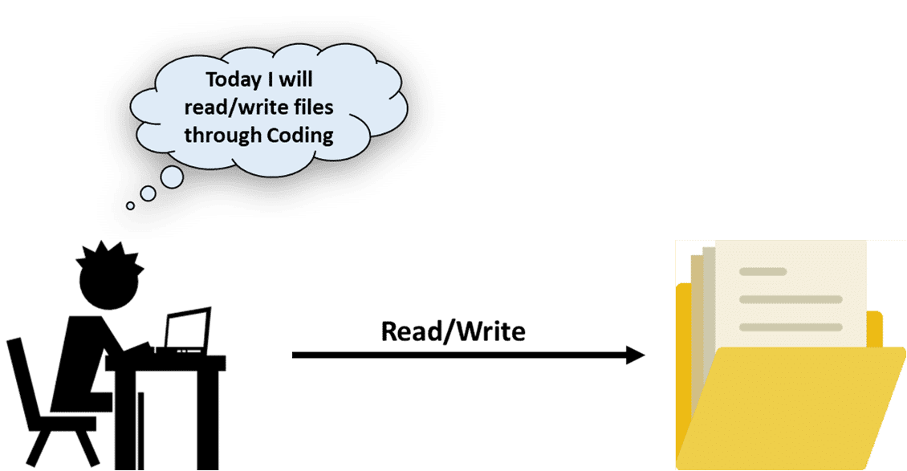
Re-cap
File-handling (reading sequential text file)

Slide 3
Re-cap: what is a sequential text file?
  Simple text files, readable by humans.
  Java has no format or structure for these files.
  Values are written/stored as separate and independent.
  Programmer imposes a record structure with newline character after each set of related values.

Slide 4
Re-cap: Creating/writing to a sequential text file
  Various Java classes can be used.
  We will use classes BufferedWriter and FileWriter
  These classes are defined in the package….?
  Methods used:
  write()
  close()
  Exceptions must be handled.

Slide 5
Re-cap: Exception-handling
At least one catch block and/or a finally block must immediately follow the try block.
If an exception occurs in a try block, the try block terminates immediately and program control transfers to the first of the following catch blocks in which the exception parameter's type matches the type of the thrown exception.

Slide 6
Re-cap: Exception-handling
After executing a catch block, this program's flow of control proceeds to the first statement after the last catch block, or…
to the statements in the finally block, if one has been defined.
Remember, a finally block is optional.
In fact, the statements in the finally block always execute, whether an exception occurred or not.

Slide 7
Reading from a sequential text file
We will use the BufferedReader and FileReader classes to read text from a file.
The record format of text files you will be asked to read will have data stored as characters with delimiters between values.
Examples of records relating to books and authors:
Lord of the Rings#Tolkien, J.R.R.#0552147486#20.00
The Legends#Clancy, T.M.#0623671233#25.00

Slide 8
Reading from a sequential text file
Construct a BufferedReader object with a FileReader object as argument
FileReader fr = new FileReader("DATCPUTL.txt");
BufferedReader br = new BufferedReader(fr);
open
Method to read one line from the text file as a String
String ln = br.readLine( );
Read and process
To close the file:
br.close( );
close

Slide 9
Reading from a sequential text file
You are given a text file called SalesDelim.txt
Each line represents a product record with the following fields:
Product Type int
Catalog number int
Item description String
Purchase price per item int
Selling price per unit int
Quantity sold int
You are required to display each product description and the quantity sold.
Let’s look at a Java-coded example:

Slide 10
StringTokenizer class
Allows you to break a string into tokens. It is simple way to split a string into substrings based on a specific delimiter.
Constructor | Description
StringTokenizer(String str, String delim) | creates StringTokenizer with specified string and delimiter.
Public method | Description
boolean hasMoreTokens() | checks if there is more tokens available.
String nextToken() | returns the next token from the StringTokenizer object.
String nextToken(String delim) | returns the next token based on the delimeter.
boolean hasMoreElements() | same as hasMoreTokens() method.
Object nextElement() | same as nextToken() but its return type is Object.
int countTokens() | returns the total number of tokens.

Slide 11
Alternative to StringTokenizer class
You can also use the split( ) method of the String class to achieve the same result

Slide 12
Try this on your own:
Read from/write to a sequential text file
You are required to determine the profit made from sales of each of the products with a product type of 1.
Write your results to a text file.
Your output should be formatted appropriately, and include headings.

Slide 13

File-handling – Serialized files

